Slide 1
Twitter Disaster
Next Hikes IT Solutions
Vincy Mehta

Slide 2
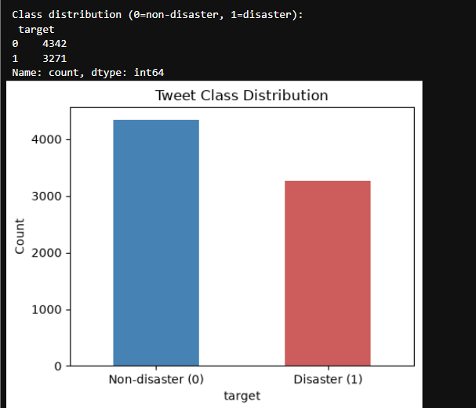
Insights :
Dataset has 7,613 tweets total — 4,342 are non-disaster tweets and 3,271 are disaster related tweets.
No major bias risk — since the gap between classes isn't extreme.
The data is fairly balanced, with about 57% non-disaster and 43% disaster tweets. This is good news because it means a machine learning model can learn both classes well without needing heavy correction for imbalance.

Slide 3
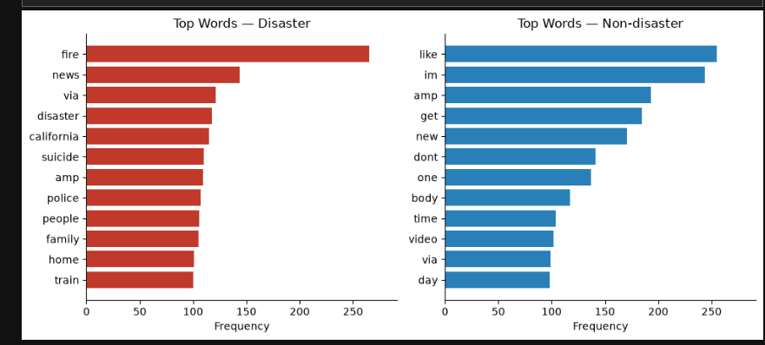
Insights :
"Fire" is the most dominant disaster keyword, appearing far more often than any other word — suggesting fire-related incidents (wildfires, building fires) are a major topic in disaster tweets.
Words like "news", "via", "police" suggest these tweets often come from or reference official/news sources, meaning disaster tweets may be more informational or shared from credible channels rather than purely personal experiences.
Clear vocabulary separation supports model reliability — the two word clouds are quite distinct (formal/urgent vs. casual/personal), which is a good sign that the model can learn meaningful patterns to distinguish disaster vs non-disaster tweets.

Slide 4
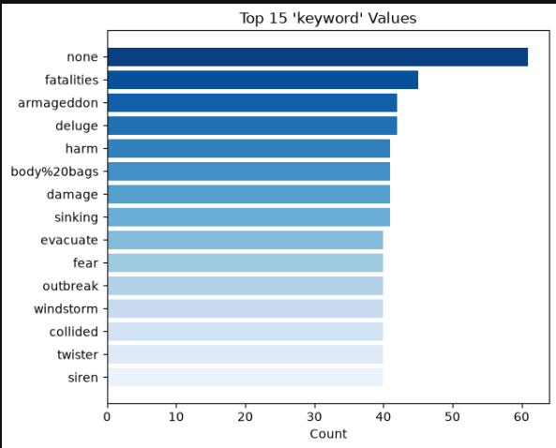
Insights :
"None" is the most frequent keyword (60+ times).
most other keywords (fatalities, armageddon, deluge, harm, damage, etc.) appear a similar number of times (around 40).

Slide 5
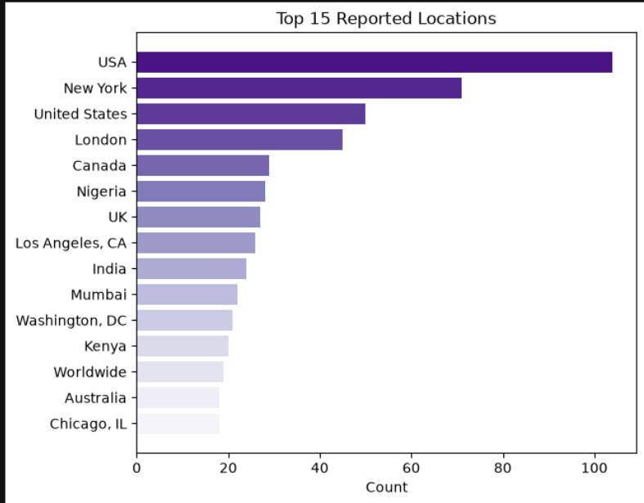
Insights :
USA dominates the location data — with 100+ mentions, most tweets in the dataset come from or reference the United States, showing a strong geographic bias toward American users/events.
Limited global representation — countries like Nigeria, India, Mumbai, and Kenya appear, but with much lower counts. This means the model may perform poorly on tweets from underrepresented regions with different disaster patterns, languages, or slang.
"Worldwide" is a generic entry — this shows some users don't share specific locations, so location data will always have some noise or unusable values.

Slide 6
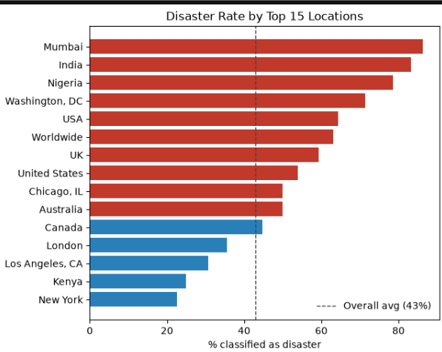
Insights :
Mumbai, India, and Nigeria have the highest disaster rates (nearly 80-85%), meaning tweets from these locations are much more likely to be genuine disaster reports, well above the overall average of 43%.
New York and Kenya have the lowest disaster rates (below 25%), meaning tweets from these places are mostly non-disaster chatter, even though they appear frequently in the dataset (especially New York).
Half the top locations are above average, half below — this shows a clear split between "high-alert" locations (Mumbai, India, Nigeria, Washington DC, USA) and "low-alert" locations (Canada, London, LA, Kenya, New York).

Slide 7
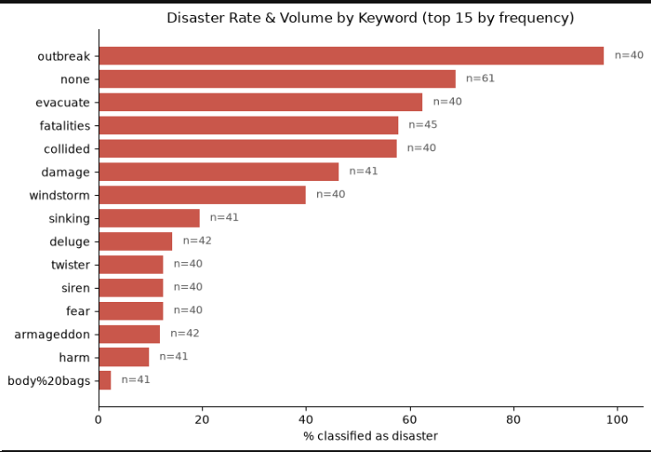
Insights :
"Outbreak" has almost 100% disaster rate — nearly every tweet with this keyword is a real disaster tweet, making it one of the most reliable predictors in the dataset.
"Evacuate," "fatalities," and "collided" are strong disaster indicators (all above 55%) — these words are commonly tied to real emergencies and can be trusted as high-confidence signals.
High-value keywords for quick alerts — "outbreak," "evacuate," "fatalities," and "collided" could be used as a fast pre-screening filter for emergency monitoring systems, flagging these tweets for immediate human review.
Low-value keywords for filtering noise — words like "body%20bags," "harm," and "armageddon" could be deprioritized or down-weighted in rule-based systems since they mostly represent non-disaster.

Slide 8
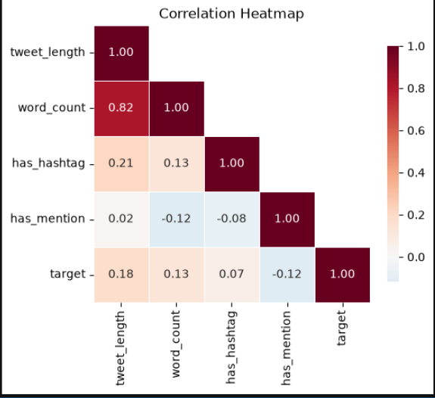
Insights :
Tweet length and word count are strongly linked (0.82) — this makes sense, since longer tweets naturally have more words. This means using both features together may be redundant for modeling.
Hashtags have almost no impact on disaster classification (0.07) — using a hashtag doesn't meaningfully indicate whether a tweet is about a disaster or not, so hashtag presence alone isn't a useful feature.
All correlations are weak overall — no single feature strongly predicts disaster vs non-disaster on its own. This confirms that simple tweet metadata (length, hashtags, mentions) is not enough — the actual text content and keywords matter much more.

Slide 9
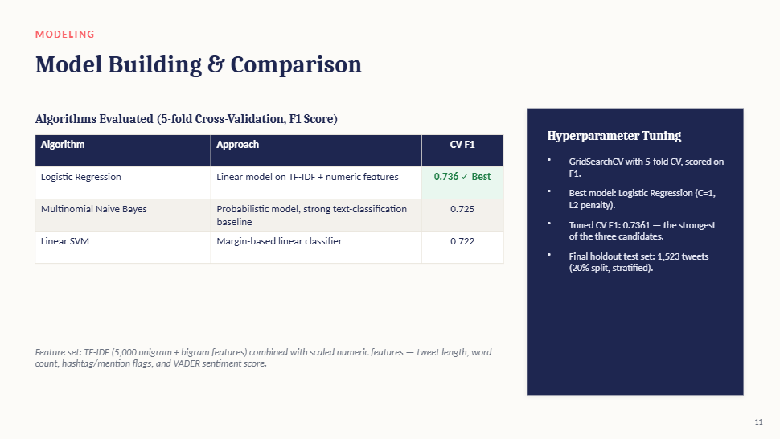

Slide 10
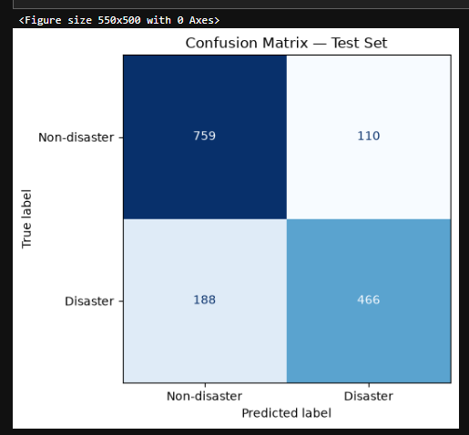
Insights :
Overall accuracy is about 80% — the model correctly classifies 1,225 out of 1,523 tweets, which is a solid baseline performance for a text classification task.
The model is better at detecting non-disaster tweets (87% recall) — out of 869 actual non-disaster tweets, it correctly identified 759, showing strong reliability for filtering out normal.

Slide 11
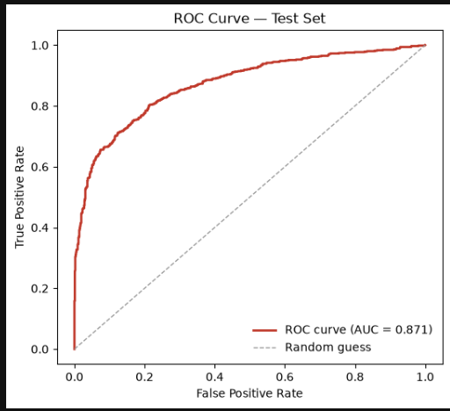
Insights :
AUC score of 0.871 shows strong model performance — this means the model is quite good at distinguishing disaster tweets from non-disaster tweets, well above random guessing (which would be 0.5).
The model performs much better than chance — the red curve stays far above the diagonal dashed line, confirming the model has real predictive power.

Slide 12
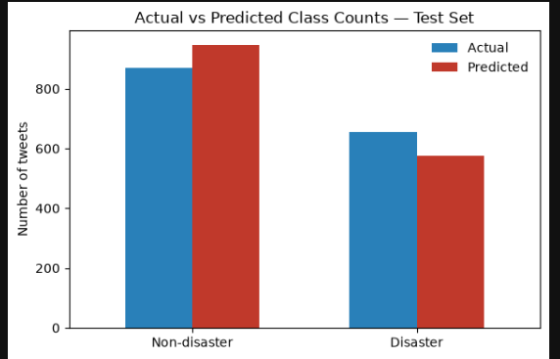
Insights :
The model over-predicts non-disaster tweets — actual non-disaster count is about 869, but the model predicted around 947, meaning it's labeling some real disasters as non-disaster.
The model under-predicts disaster tweets — actual disaster count is about 654, but the model only predicted around 576.
overall accuracy was around 80%, this chart visually shows the model consistently shifts predictions away from the disaster class.

Slide 13
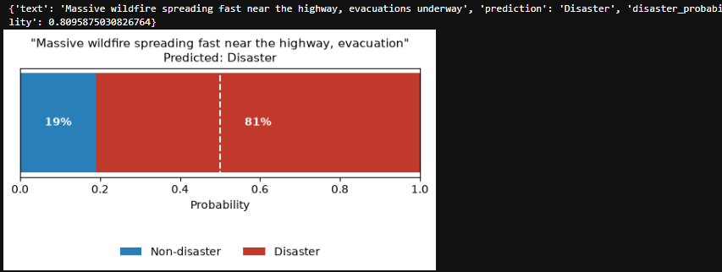
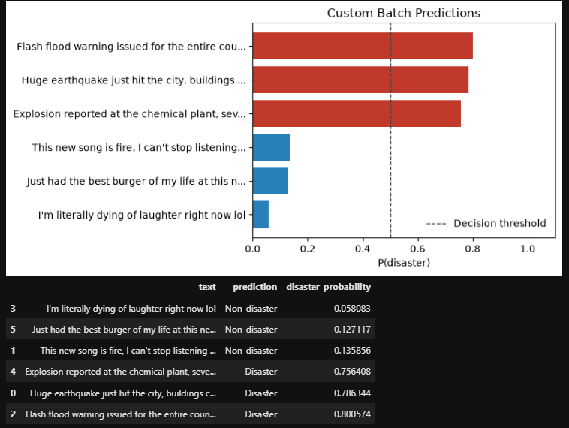
Insights :
Model perfectly separates disaster vs non-disaster in this batch — all 6 predictions are correctly classified, with a clear gap between disaster tweets (75-80%) and non-disaster tweets (5-14%), showing strong confidence in both directions.
model handles slang and idioms well — this is important because words like "fire" or "dying" could easily confuse a simpler keyword-based system, but this model correctly reads them in proper context.
Insights :
The model confidently predicts a real disaster — with 81% probability, the tweet "Massive wildfire spreading fast near the highway, evacuations underway" is correctly classified as a disaster, showing strong real-world applicability.

Slide 14
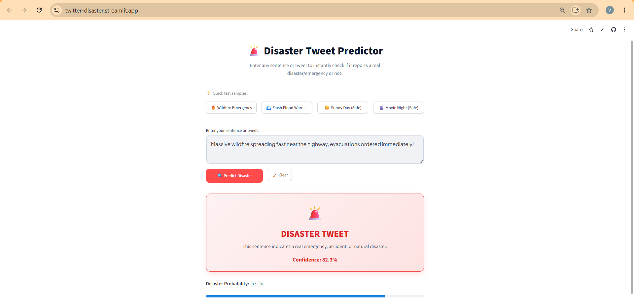
Streamlit : https://twitter-disaster.streamlit.app

Slide 15
Thank You

